Slide 1
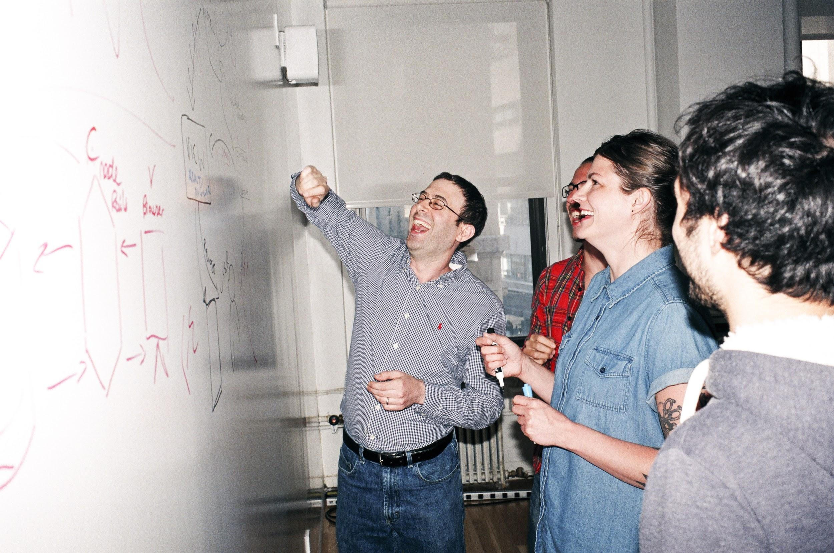

Welcome to General Assembly
WiFi GA Guest
Password yellowpencil
Notes:
[Leave this slide visible until presentation starts]

Slide 2
DATA SCIENCE
DAT10SYD
Week 3 - Model Evaluation

Slide 3
Course Plan
Paul & James review final project ideas

Slide 4
Git & GitHub – 1 Pager Guide!

Slide 5
AGENDA
Evaluating machine learning models
Why is this important?
Correctly assessing the accuracy of a model
Lab
Review

Slide 6
THE POINT OF EVALUATING MODELS
DATA SCIENCE PART TIME COURSE

Slide 7
EVALUATING MODELS
Why do we need to evaluate models?
Why might we need to be rigorous in evaluating models?

Slide 8
ESSENTIALS OF MODEL EVALUATION
DATA SCIENCE PART TIME COURSE

Slide 9
TRAINING ERROR
Q: What’s wrong with training error?

Slide 10
TRAINING ERROR
Q: What’s wrong with training error?
A: Training error is not a good estimate of
accuracy beyond training data.

Slide 11
TRAINING ERROR
Q: How low can we push the training error if we can make the model arbitrarily complex. Effectively “memorizing” the entire training set ?

Slide 12
TRAINING ERROR
Q: How low can we push the training error if we can make the model arbitrarily complex. Effectively “memorizing” the entire training set ?
A: Down to zero!

Slide 13
TRAINING ERROR
Why this matters
The data that we are given for prediction won’t always be the end of the data we are interested in! We may not have access to all the data of interest
We will gather data and build and iterate over models however a main reason for building the model was to predict unseen test cases.

Slide 14
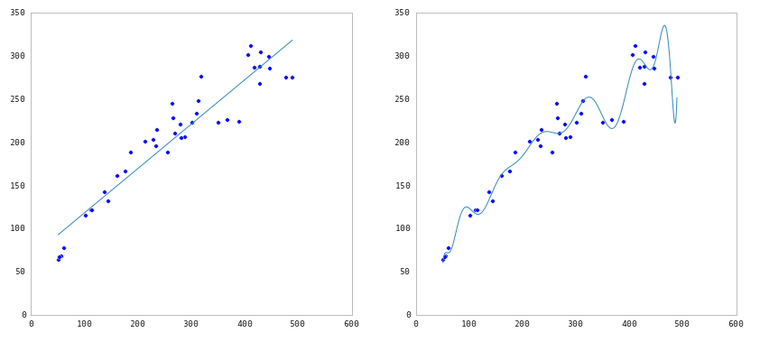
TRAINING ERROR

Slide 15
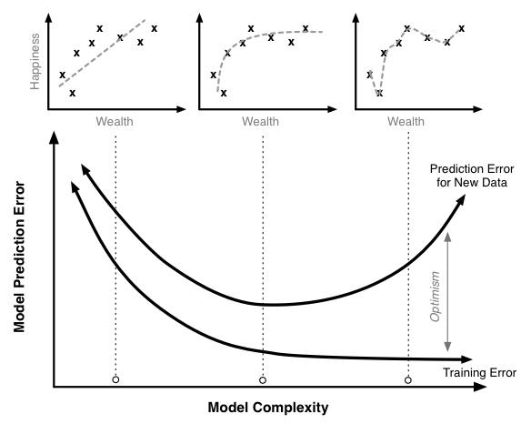
TEST vs TRAIN

Slide 16


TEST SET APPROACH
Q: How can we make a model that generalises well?
model
dataset

Slide 17
TEST SET APPROACH
Q: How can we make a model that generalises well?
1) split dataset
model
dataset

Slide 18

TEST SET APPROACH
Q: How can we make a model that generalizes well?
1) split dataset
2) train model
training set
model
dataset

Slide 19

TEST SET APPROACH
Q: How can we make a model that generalizes well?
1) split dataset
2) train model
3) test model
training set
model
test set
dataset

Slide 20
TEST SET APPROACH
Q: How can we make a model that generalizes well?
1) split dataset
2) train model
3) test model
4) parameter tuning
training set
model
test set
dataset

Slide 21
TEST SET APPROACH
Q: How can we make a model that generalizes well?
1) split dataset
2) train model
3) test model
4) parameter tuning
5) choose best model
training set
model
test set
dataset

Slide 22
TEST SET APPROACH
Q: How can we make a model that generalizes well?
1) split dataset
2) train model
3) test model
4) parameter tuning
5) choose best model
6) train on all data
training set
model
test set
dataset

Slide 23

TEST SET APPROACH
Q: How can we make a model that generalizes well?
1) split dataset
2) train model
3) test model
4) parameter tuning
5) choose best model
6) train on all data
7) make predictions
on new data
training set
model
test set
new data
dataset

Slide 24

TEST SET APPROACH
Q: How can we make a model that generalizes well?
1) split dataset
2) train model
3) test model
4) parameter tuning
5) choose best model
6) train on all data
7) make predictions
on new data
NOTE
This new data is called out of sample data. We don’t know the labels for these OOS records!
We want to estimate OOS prediction error so we know what to expect from our model.
training set
model
test set
new data
dataset

Slide 25
BIAS & VARIANCE TRADEOFF
BIAS
When we are training over multiple data sets we will have different errors. Bias tells if there is a systematic difference between model and actual
VARIANCE
This is how variable our model is for a given data point.
Variance tell us how spread the predicted values are from the actual

Slide 26
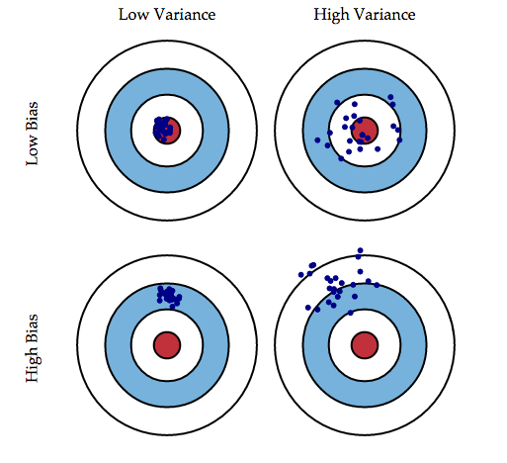
BIAS - VARIANCE TRADEOFF
26￼
BIAS
Bias tells if there is a systematic difference between model and actual.
e.g. Are the means significantly different?
VARIANCE
Variance tell us how spread the predicted values are from the actual.
Shouldn’t be able to do better than that spread of the actual data.

Slide 27

BIAS - VARIANCE TRADEOFF

Slide 28
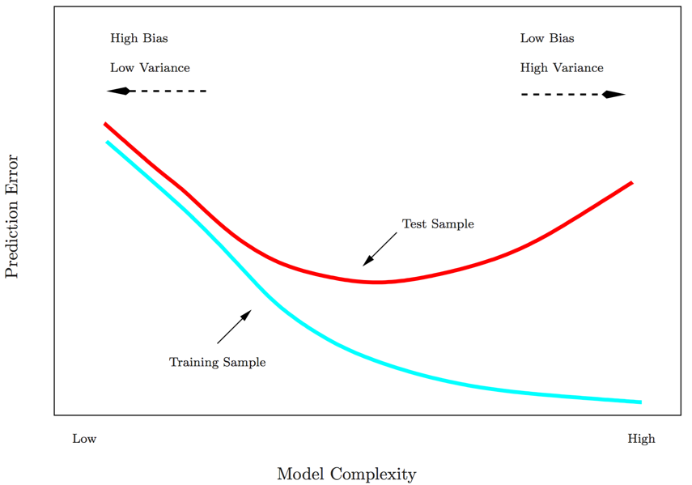
BIAS - VARIANCE TRADEOFF

Slide 29
LAB1 - Bias / Variance
DATA SCIENCE PART TIME COURSE

Slide 30
Git & GitHub – 1 Pager Guide!

Slide 31
CROSS VALIDATION
DATA SCIENCE PART TIME COURSE

Slide 32
TEST SET APPROACH
Suppose we do the train/test split.
Q: How well does test set error predict Out of Sample Error?

Slide 33
TEST SET APPROACH
Suppose we do the train/test split.
Q: How well does test set error predict Out of Sample Error?
A: On its own, not very well.

Slide 34
TEST SET APPROACH
Suppose we do the train/test split.
Q: How well does test set error predict Out of Sample Error?
A: On its own, not very well.
Thought experiment:
Suppose we had done a different train/test split.
Q: Would the test set error remain the same?

Slide 35
TEST SET APPROACH
Suppose we do the train/test split.
Q: How well does test set error predict Out of Sample Error?
A: On its own, not very well.
Thought experiment:
Suppose we had done a different train/test split.
Q: Would the test set error remain the same?
A: Of course not!
NOTE
The test set error gives a high-variance estimate of OOS accuracy.

Slide 36
TEST SET APPROACH
Something is still missing!
Thought experiment:
Different train/test splits will give us different test set errors.
Q: What if we did a bunch of these and took the average?
A: Now you’re talking!
Cross-validation!

Slide 37
CROSS VALIDATION
Steps for K-fold cross-validation:
Randomly split the dataset into K equal partitions.
Use partition 1 as test set & union of other partitions as training set.
Calculate test set error.
Repeat steps 2-3 using a different partition as the test set at each iteration.
5) Take the average test set error as the estimate of OOS accuracy.

Slide 38
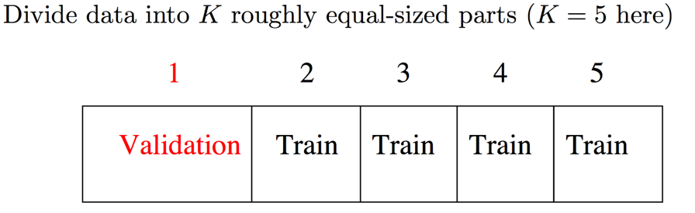
CROSS VALIDATION

Slide 39
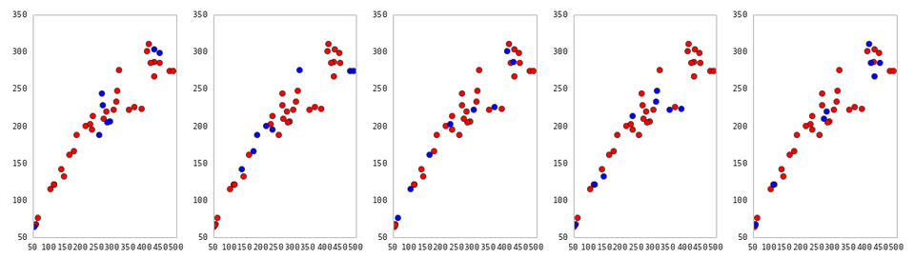
CROSS VALIDATION
5-fold cross-validation: red = training folds, blue = test fold
Source: http://nbviewer.ipython.org/github/fonnesbeck/Bios366/blob/master/notebooks/Section6_3-Model-Selection-and-Validation.ipynb

Slide 40
CROSS VALIDATION
Features of K-fold cross-validation:
More accurate estimate of OOS prediction error.
More efficient use of data than single train/test split. - Each record in our dataset is used for both training and testing.
Presents tradeoff between efficiency an computational expense. - 10-fold CV is 10x more expensive than a single train/test split
Can be used for parameter tuning and model selection.

Slide 41
CONFUSION MATRIX
DATA SCIENCE PART TIME COURSE

Slide 42
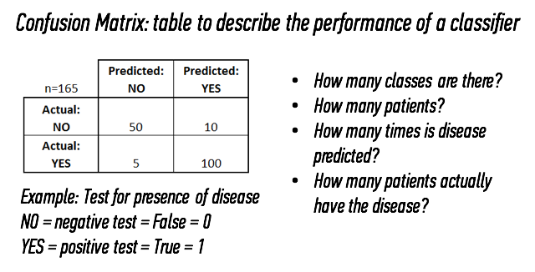
CONFUSION MATRIX

Slide 43
CONFUSION MATRIX

Slide 44
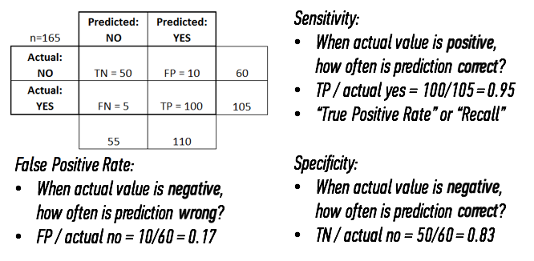
CONFUSION MATRIX

Slide 45
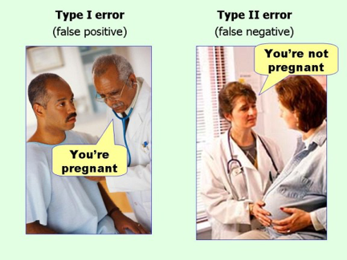
CONFUSION MATRIX

Slide 46
PRECISION & RECALL
Precision :
of those we guessed were positive, how often were we right?
Recall = Sensitivity :
how many of actual positives did we capture?
F1 measure :
balance of Precision and Recall

Slide 47
LAB - Evaluation Metrics
DATA SCIENCE PART TIME COURSE

Slide 48
DATA SCIENCE PART TIME COURSE
DISCUSSION TIME
Questions from previous lesson?
What are we trying to do when we use Logistic Regression?
How would you evaluate a regression problem?

Slide 49
QUESTIONS
What are we trying to do when we use Logistic Regression?
Why use it instead of Linear Regression for classification?
Evaluating a logistic Regression model

Slide 50
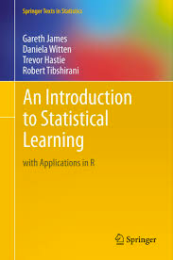
HOMEWORK
Pre-reading: An Introduction to Statistical Learning Chapter 6 - Model selection & regularisation
Caltech's Learning From Data course visualising bias and variance (15 mins)
http://work.caltech.edu/library/081.html
Rahul Patwari has a great video on ROC Curves (12 minutes)
https://www.youtube.com/watch?v=21Igj5Pr6u4
Have a look at scikit-learn’s documentation on model evaluation
http://scikit-learn.org/stable/modules/model_evaluation.html
DATA SCIENCE

